Slide 1
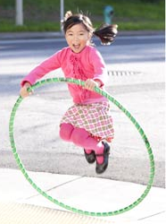
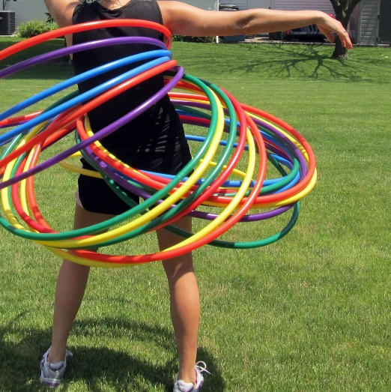
Can you be a super star skipper?
Can you hula as a group!
Are you ready for the
hula challenge?
Who can hula for the longest?
Who can hula with the most hoops?
Send us photos or videos of your challenge ideas to csspadmin@netherhallschool.org or share them on the CSSP Facebook or twitter page

