Slide 1
Sporting Spirit
What do we mean by ‘sporting spirit’ or
‘being a good sport’?
Notes:
Ask the children the question: What do we mean by Sporting Spirit or being a good sport?
Sport isn’t just about winning and losing or beating others.
We all play to win but it isn’t the most important thing.
It’s about taking part in the spirit of the game
It’s about the experience, fun and enjoyment of sport and giving your best.
Developing a love of sport versus a love of winning
Play the video which is embedded on the next slide

Slide 2
Notes:
Play video embedded above or from link below
https://www.youtube.com/watch?v=diwhrryrWv0

Slide 3
Spirit of the Games Values
These 6 values identify what school sport and competition should be about.
Notes:
The Spirit of the Games Values focus on personal excellence through competition.
The six values were developed by young people to identify what the experience of school sport and competition should be about.
They are the values of the School Games and they support you to strive to do your best and help you to achieve sporting success.
So let’s think more about what each of these values mean in sport, school and life. What can we learn from sport, what important life skills can we develop?

Slide 4
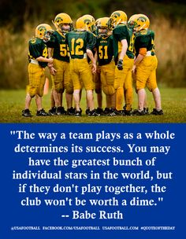
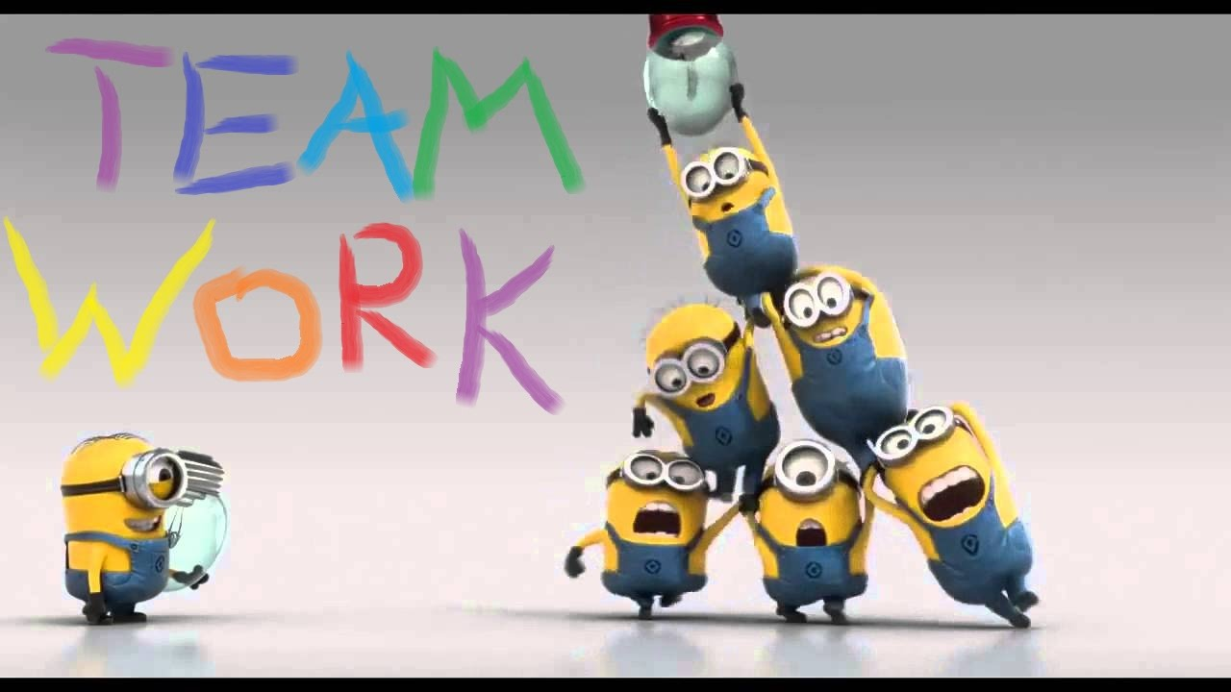
What does teamwork mean to you?
Notes:
Question: What does team work mean to you? Explain the pictures on the slide in your own words.
Teamwork
Treating everyone equally and valuing each individual
Supporting each other and working together to have fun and achieve.
Celebrate each other’s success
Be a good friend and a positive team player in school, sport and life
Having a common goal
Developing a good team spirit
Giving everyone a chance to take part
Are you a good team player? Who in your class is? Why?
e.g John is because he always makes sure everyone gets a go and he says well done

Slide 5
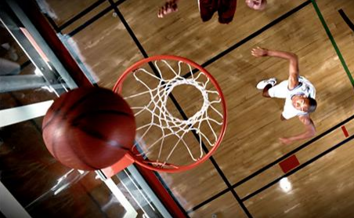
How might you demonstrate honesty when playing sport?
Why is honesty important?
Notes:
Ask the question: What is honesty?
1. Always telling the truth
2. Never cheating
3. Admitting when I am wrong
With others and with yourself.
Have the courage to do the right thing and what you know is right.
Let the best person win not the best cheat!
Get the children to think about and answer the other questions on the slide.
Play the basketball video by clicking the picture on the slide or use the link below as a good example of honesty in sport
http://www.values.com/inspirational-stories-tv-spots/106-basketball

Slide 6
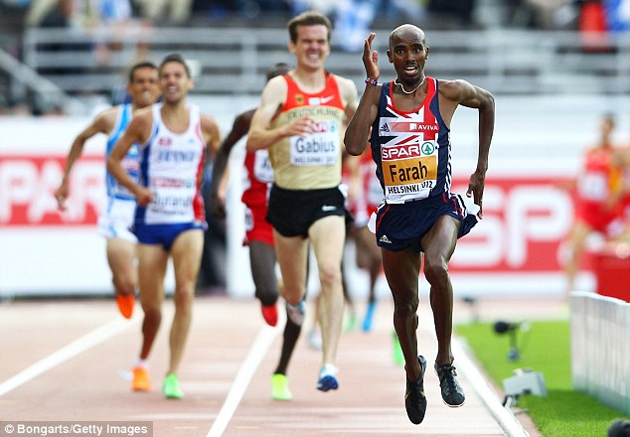
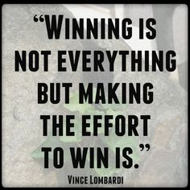
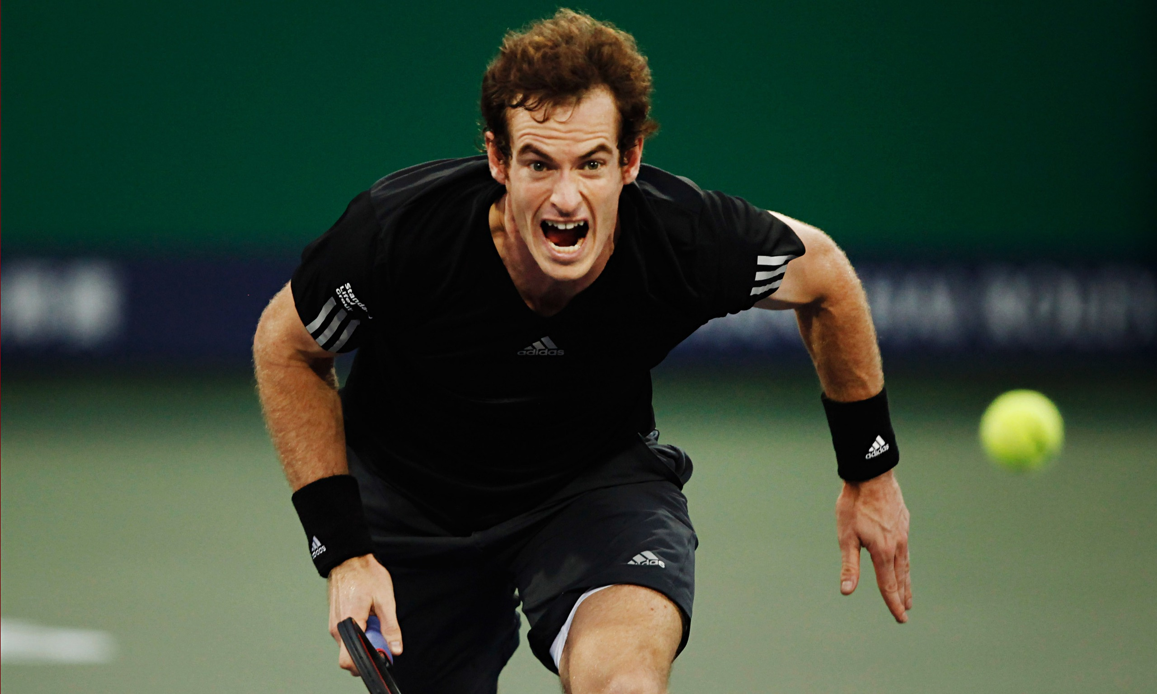
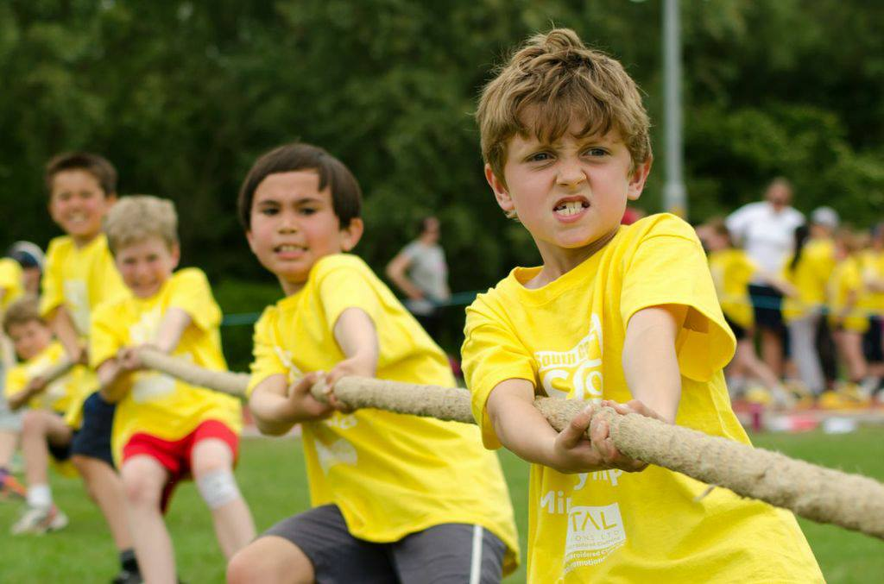
“Champions keep playing until they get it right.”
Billie Jean King
Notes:
Question: What do these pictures tell us about the meaning of determination?
Determination is…
about the journey you go on to push yourself and achieve your dreams.
Keep going no matter what.
Have the mental strength and the self-discipline to overcome obstacles, commit to your goals and keep working every day to become the very best you can be. Don’t hold back!
Competitions can be extremely hard work but the satisfaction I feel when I have met or exceeded my expectations can outweigh the sweat and pain
When have you shown determination in sport or everyday life?
Is there something at school you had to work really hard at to improve or achieve a goal/task?
How did it make you feel when you achieved your goal?

Slide 7
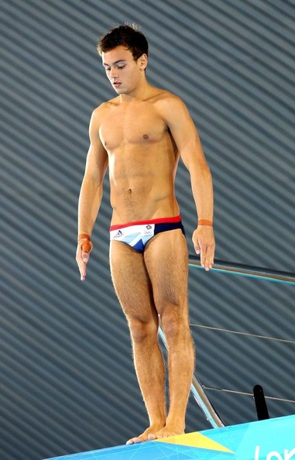
Preparation and self belief are very important in sport in order to ensure that I can give my all and perform to the best of my abilities. The more I have practised, the more confident I have become and I now have the self belief every time I compete or am faced with learning a new skill.
Notes:
Why is self-belief really important for someone like Tom Daley when standing on that diving board 10metres above the pool?
Self Belief
You’ve got to believe to achieve.
Have the self belief and confidence to succeed and reach your personal best.
Push the boundaries – anything is possible
Being brave, taking on new challenges
Being confident
Trying new sports or activities
Why is self belief important in school/life?

Slide 8
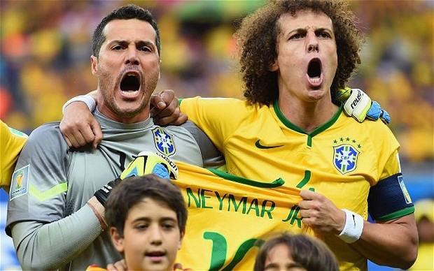
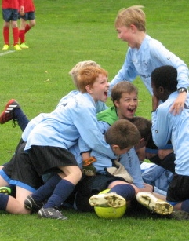
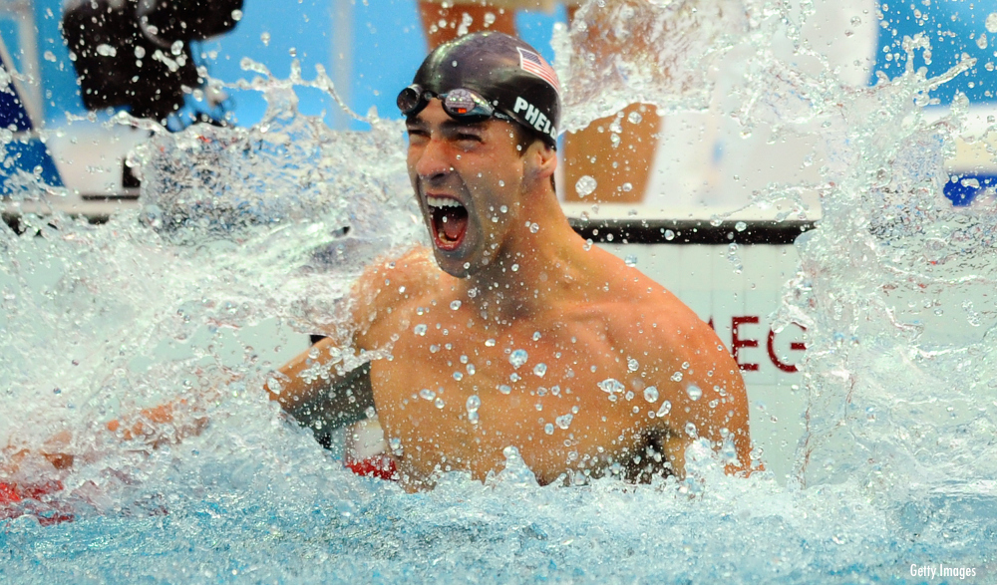
Notes:
Passion is ….
1. Being positive and enjoying the game/activity
2. Trying my best
3. Keep trying if I don’t get it right
Giving it 100%, putting your heart and soul into the game and never giving up.
Passion makes you enter the race and passion makes you finish it.
We can’t all be winners but we can all give it 100%!
Think of something you are really passionate about, how does it make you feel when you know you have given it your best effort and tried your hardest no matter the outcome?

Slide 9
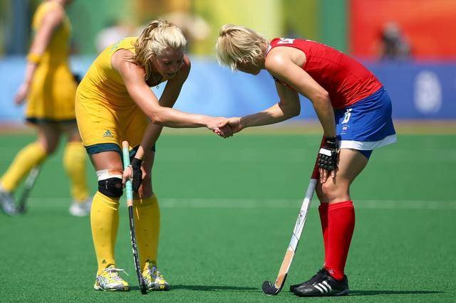
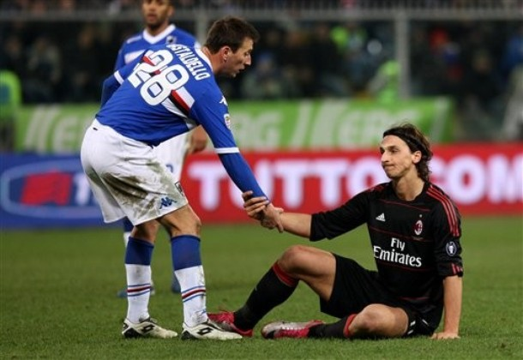
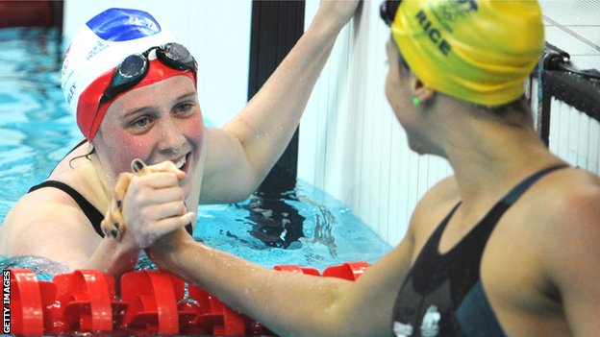
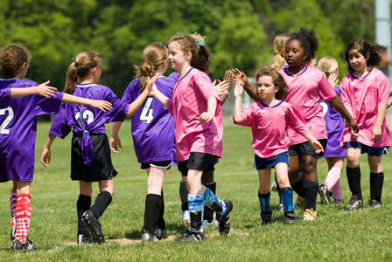
How might you
demonstrate respect in school sports competitions?
Notes:
Question: How might you demonstrate respect when representing the school in sports competitions?
Being polite, not shouting or losing my temper
Shaking hands with the other players and thanking them for the game
Listening to the coach/teacher
Always accepting the referees decisions
Listening carefully
Taking care of all equipment and kit
Respect …
For your team mates and your opponents
For the referees, officials and volunteers who put so much time into ensuring competitions can take place safely and enjoyably
Accepting victory and defeat with grace, treating others politely and with understanding.

Slide 10
Notes:
The Cambridge School Sports Partnership will be awarding schools and individuals for displaying these values at our comps this year. There are stickers, certificates and school prizes.
These values can be adopted in schools and other areas of the curriculum as well.

